Slide 1
The History of Common Inventions
“Unveiling the Origins of Everyday Innovations”
Presenter:
Nakul Kachhava

Slide 2
INDEX
THE WHEEL
THE KNIFE
THE PULLEY

Slide 3
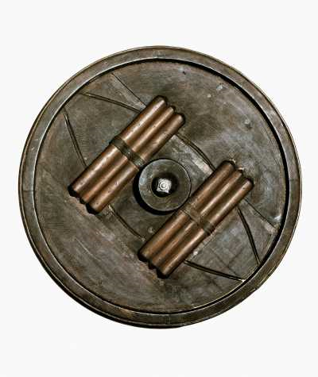
The Wheel
The wheel was invented before records were kept, nobody can ever know who invented the wheel.
However, the ancient Mesopotamian (modern-day Iraq) people are widely believed to have invented the wheel around 4200-4000 BC.
The first wheels were potter's wheels and were not used for transportation, known as "slow wheels".
Understanding the "invention" of the wheel requires recognizing that it was a gradual process, not a singular event.

Slide 4
The Wheel
Early Transportation:
Solid, heavy wooden disc wheels developed for carts and wagons.
2000 BCE, Anatolia:
Spoked wheel was invented, significantly reducing weight and improving speed.
Material Advancements:
Iron rims added for durability.
Steel and alloy wheels developed during the Industrial Revolution.
19th Century:
Pneumatic (air-filled) tire invented, greatly enhancing ride quality and speed.

Slide 5
The Wheel
Impact on Society:
The wheel revolutionized transportation, making it easier to move goods and people over long distances.
It also had a significant impact on agriculture, enabling the use of animal traction and irrigation systems.
The wheel played a crucial role in the development of various industries, including pottery, milling, and construction.

Slide 6
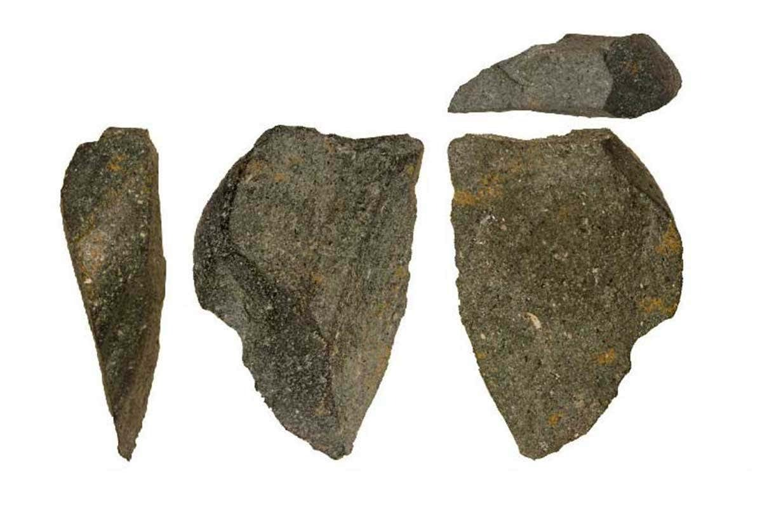
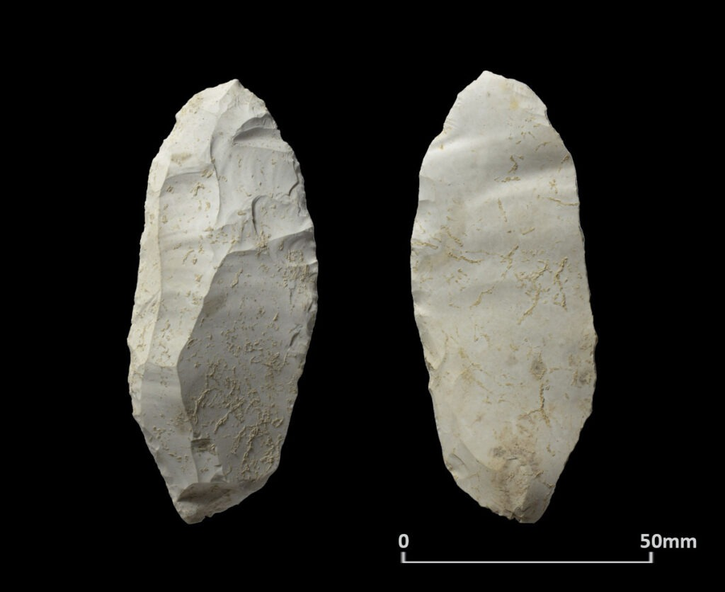
The Knife
The invention of knife is not attributable to a single inventor.
The earliest "knives" were crude stone tools, dating back approximately 2.5 million years, used by early hominids.
The need for cutting tools arose from the fundamental needs for survival: butchering animals, processing food, and defense.
Initially, it involved selecting naturally sharp stones. Later, techniques were developed to intentionally fracture stones (like flint) to create sharp edges.
Over time, humans learned to shape and refine these stone tools. The discovery of metallurgy led to the creation of metal knives.

Slide 7
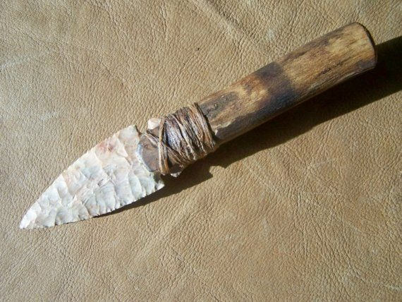
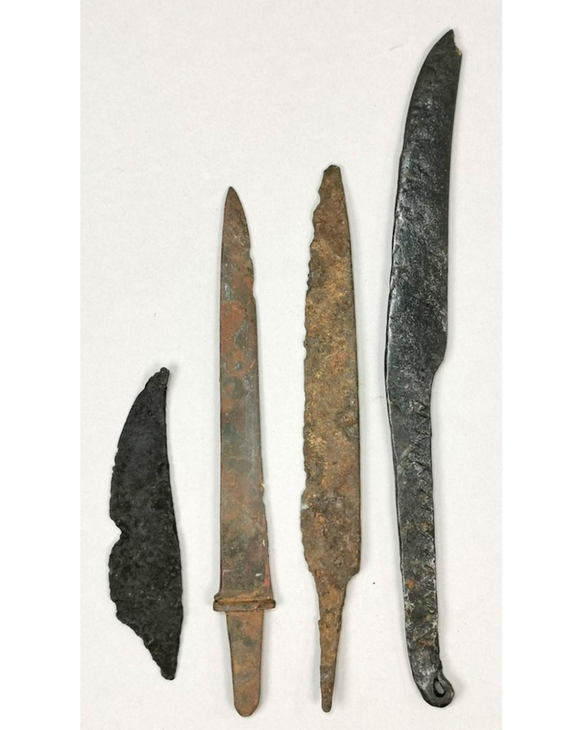
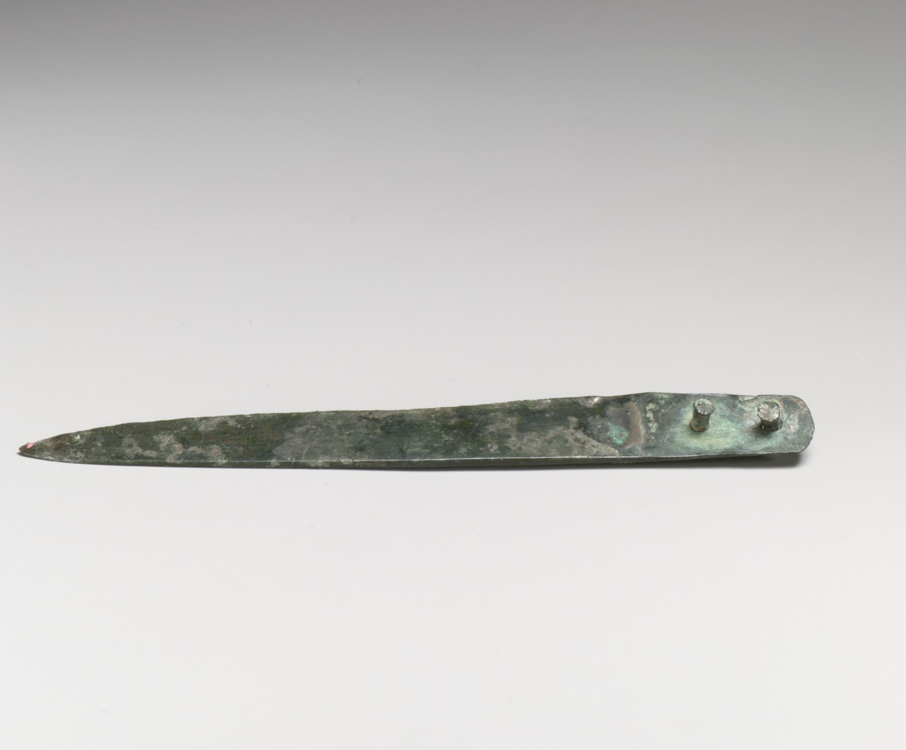
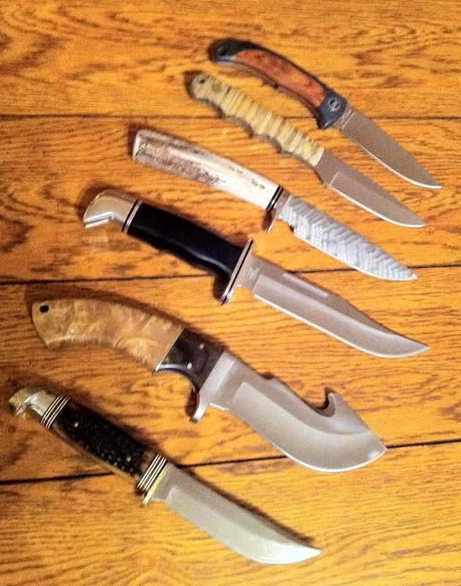

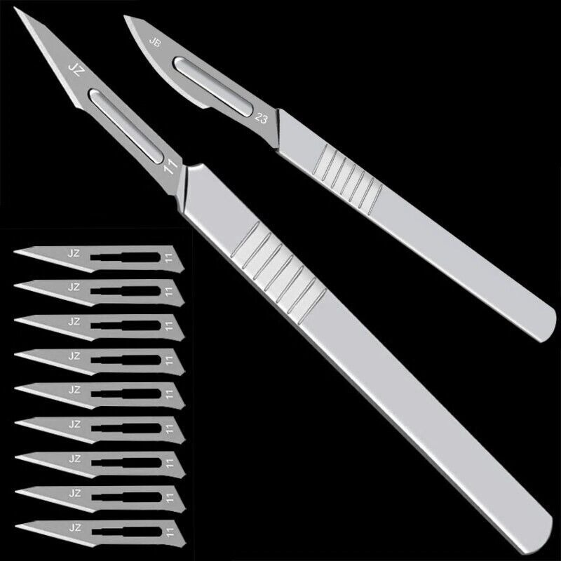
The Knife
Stone Age: The earliest knives were simple, fractured stones. Later, more refined stone blades were created, sometimes with handles.
Bronze Age: The development of bronze allowed for the creation of stronger, more durable knives.
Iron Age: Iron further improved knife durability and sharpness.
Modern Era: Modern knives are made from a wide range of materials and Knife design has become highly specialized, with knives designed for specific purposes.

Slide 8
The Knife
Impact on Social Life:
Survival: Knives were essential for hunting, butchering, and processing food, enabling early humans to survive.
Tool Use: Knives became essential tools for a wide range of tasks, from woodworking to construction.
Warfare: Knives have been used as weapons throughout human history.
Food Preparation: Knives are essential tools in modern kitchens, enabling the preparation of a wide variety of foods.
Medicine: Surgical knives are essential tools in modern medicine.

Slide 9
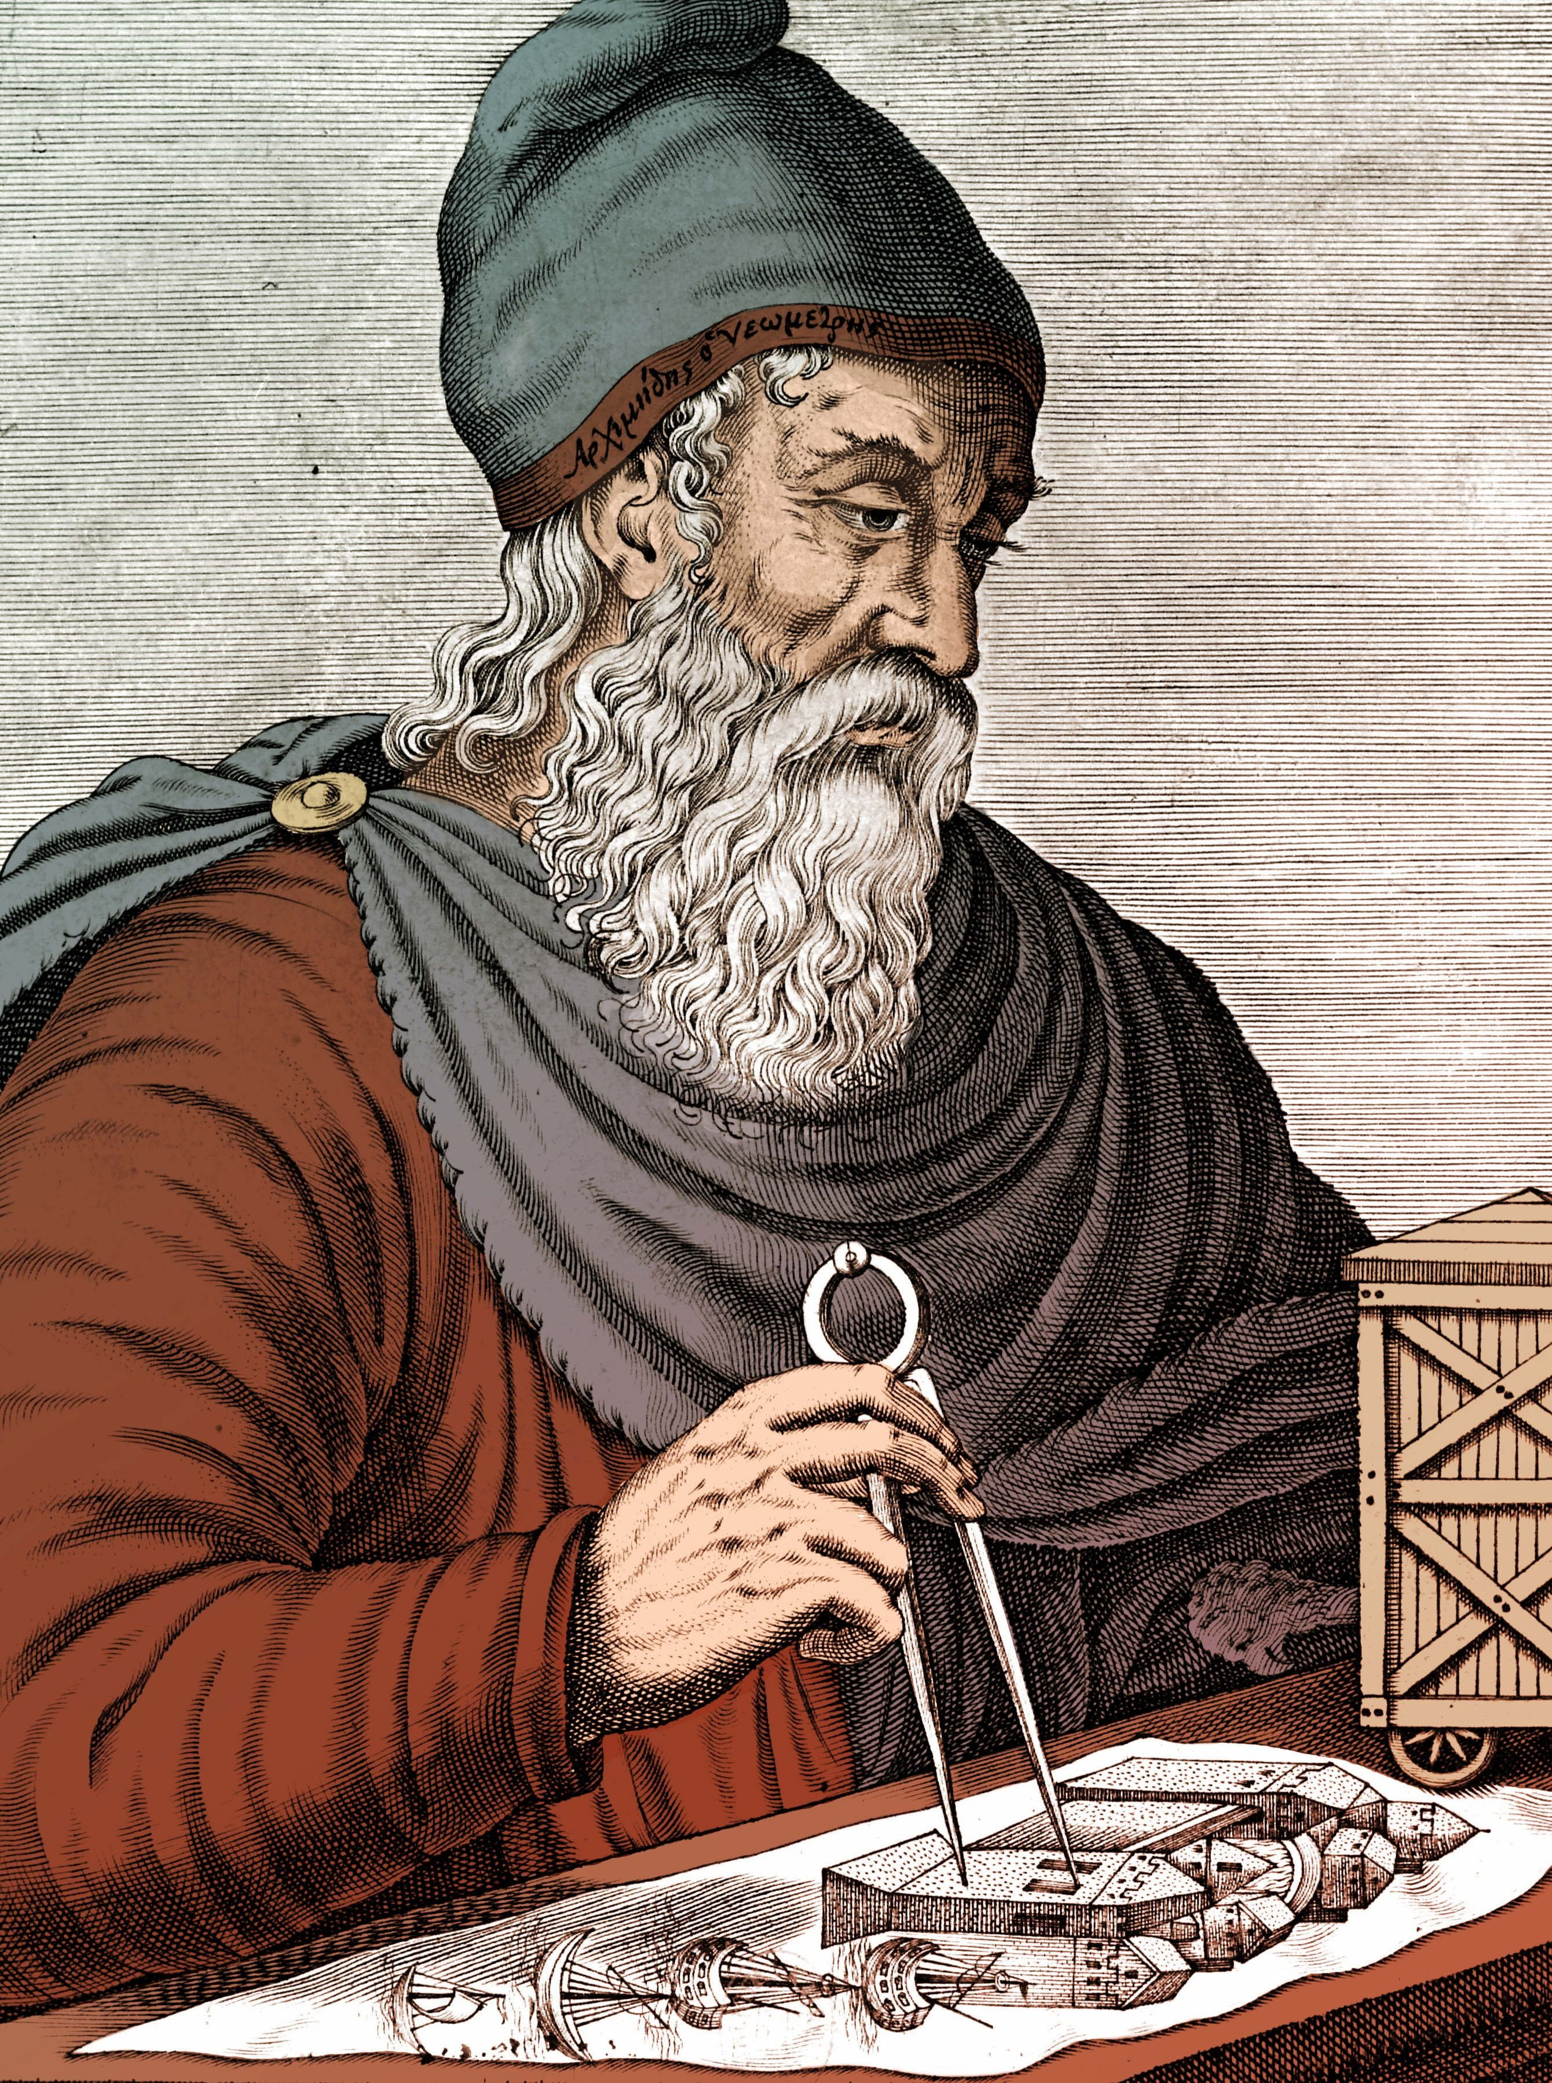
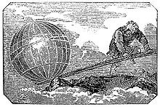
The LEVER
It's impossible to pinpoint a single inventor or precise date. The lever's principle was likely discovered through observation and practical use over a long period.
However, the Greek mathematician Archimedes (3rd century BCE) is famously associated with the lever, having articulated its principles.
His famous quote, "Give me a lever long enough and a fulcrum on which to place it, and I shall move the world," highlights his understanding of its power.

Slide 10
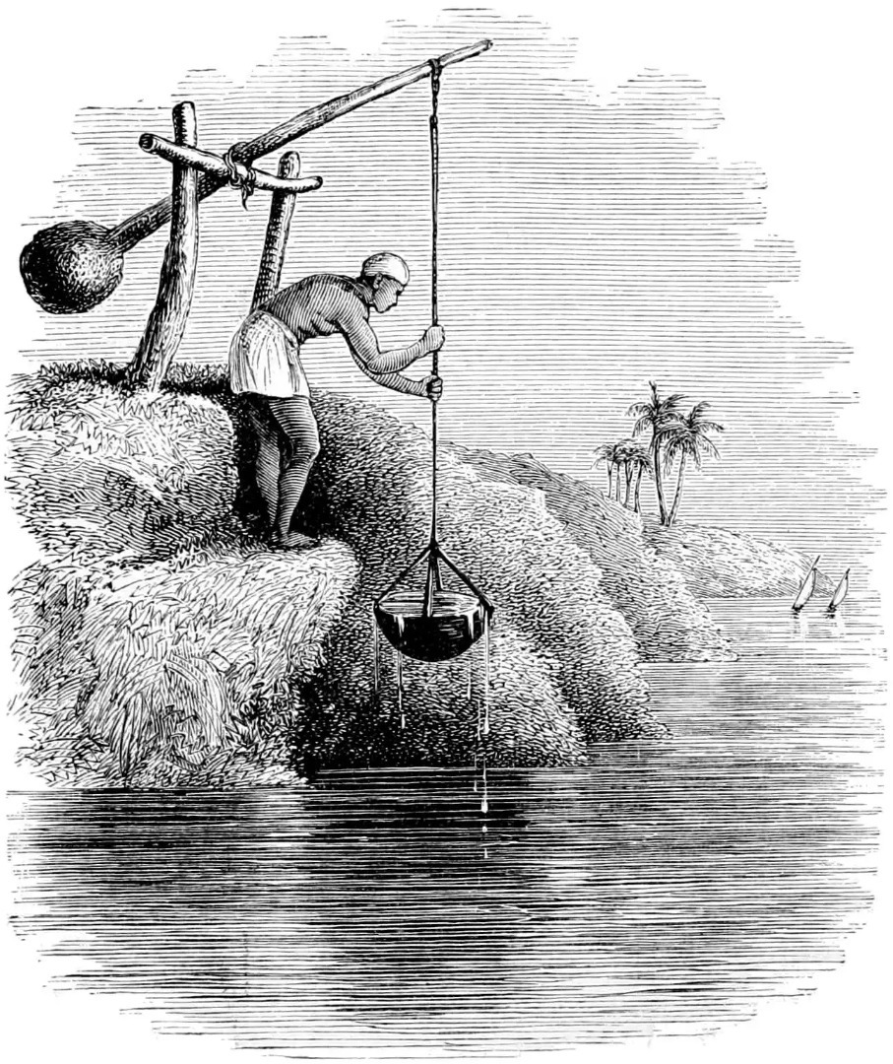
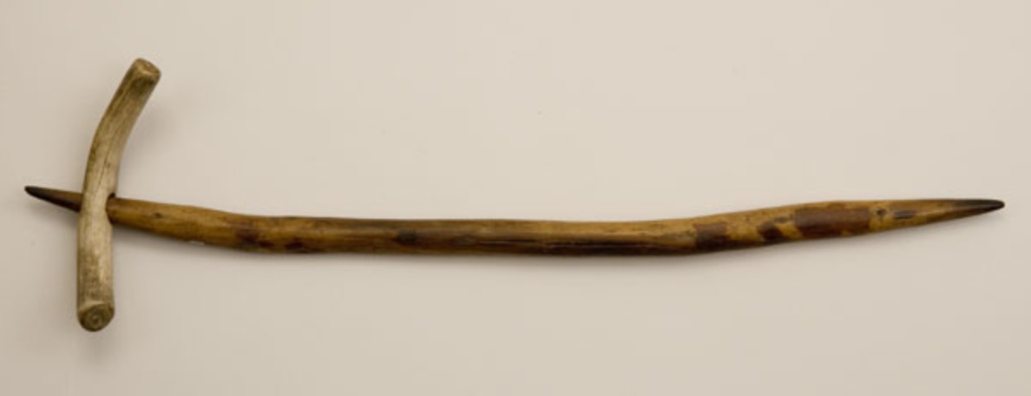
The LEVER
Evolution:
Early Use:
Simple levers made from wood or stone.
Use in basic tools like digging sticks and balance scales.
Ancient Civilizations:
Use in large-scale construction, like moving heavy stones for pyramids and other monuments.
Refinement of lever-based devices like the shaduf for crop irrigation.

Slide 11
The LEVER
Evolution:
Classical Era ( 8th Century BCE to 5th Century CE ):
Archimedes' codification of the lever's principles.
Development of more sophisticated lever-based machines.
Modern Era:
Integration of lever principles into countless machines and tools.
Continued refinement of lever-based technology in various industries.

Slide 12
The LEVER
Impact on Social Life:
Construction: Enabled the construction of massive structures that would have been impossible with human strength alone.
Agriculture: Improved efficiency in farming through tools like the shaduf and other lever-based devices.
Trade: Facilitated the movement of goods and resources.
Technology: The lever's principle is fundamental to many mechanical devices, from simple tools to complex machines.
General Productivity: Increased human productivity by enabling us to accomplish tasks with less effort.

Slide 13
INDEX
4. THE TELEPHONE
5. THE CAMERA
6. THE COMPUTER

Slide 14
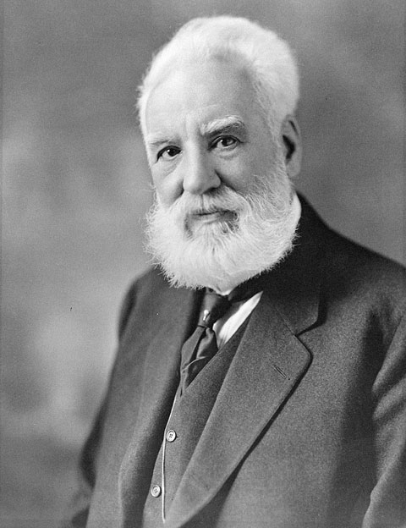
The Telephone
Alexander Graham Bell is credited with inventing the first practical telephone, receiving a patent on March 7, 1876.
Elisha Gray also developed a similar telephone device around the same time as bell, leading to a famous patent dispute
Bell's invention involved converting sound waves into electrical signals, transmitting those signals over a wire, and then converting them back into sound waves at the receiving end.
The first words spoken over the telephone were by Bell to his assistant, Thomas Watson: "Mr. Watson, come here – I want to see you."

Slide 15
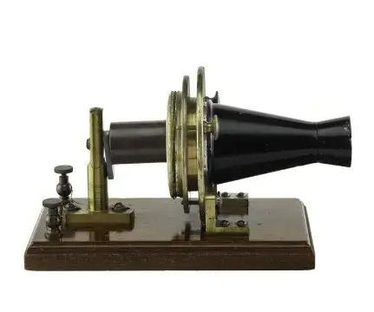
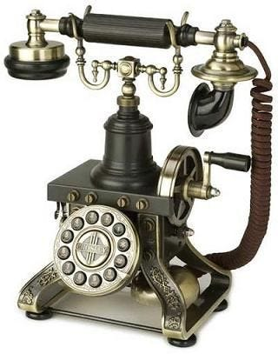

The Telephone
Early telephones were simple devices, but they quickly evolved with improvements in:
Switching systems.
Long-distance transmission.
The development of rotary and push-button dialing.
The eventual transition to digital technology.

Slide 16
The Telephone
Impact on Social Life:
The telephone revolutionized communication, enabling instant voice communication over long distances.
It transformed:
Business practices.
Social interactions.
Emergency services.
And ultimately the way the world connects.
It has shrunk the world, allowing for near instantaneous communication.
The modern smartphone, has increased the impact of the telephone exponentially, giving access to the internet, and many other forms of communication.

Slide 17
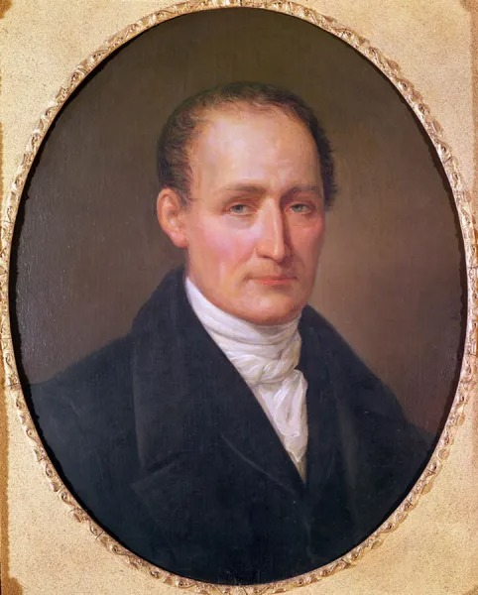
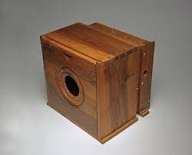
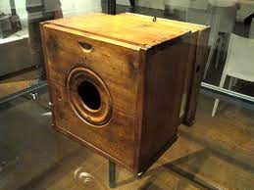
The Camera
French inventor Joseph Nicéphore Niépce is credited with creating the first photographic camera. ( 1816 )
He experimented with capturing images using light-sensitive materials.
In 1826 or 1827, he produced the oldest surviving photograph, "View from the Window at Le Gras."

Slide 18
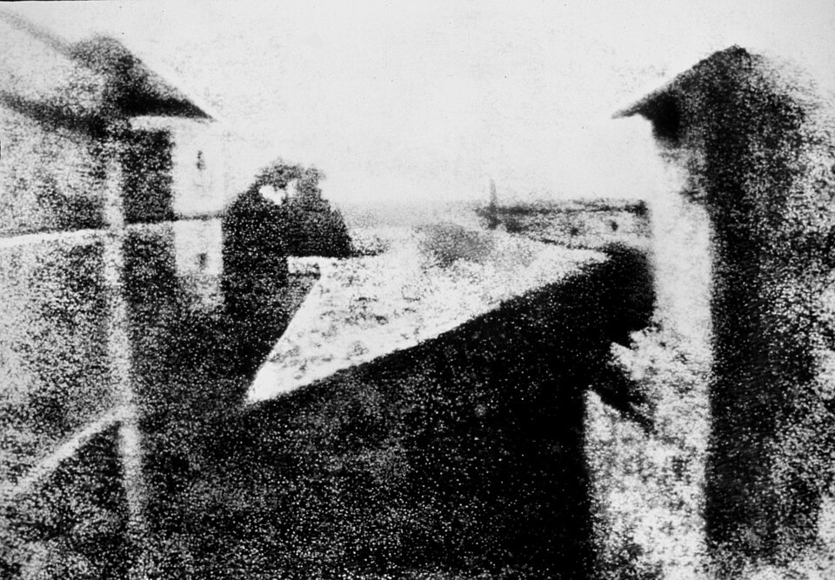
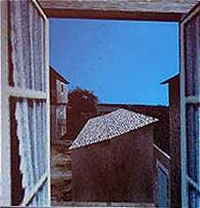
The Camera
View from the Window at Le Gras

Slide 19
The Camera
Camera technology progressed through:
Film photography, with the development of roll film and advancements in image processing.
The rise of color photography.
The digital revolution, which transformed photography with digital sensors and image storage.
The integration of cameras into smartphones, making photography ubiquitous(very common).
The continuing advancement of digital photography, and the use of AI in photography.

Slide 20
The Camera
Impact on Social Life:
Cameras have allowed us to document history, personal memories, and events.
Photography plays a crucial role in journalism, advertising, and entertainment.
Photography has become a powerful form of visual communication.
Cameras have provided a tool for artistic expression and creativity.
The rise of social media has amplified the role of photography in our lives, with people constantly sharing images and videos.

Slide 21
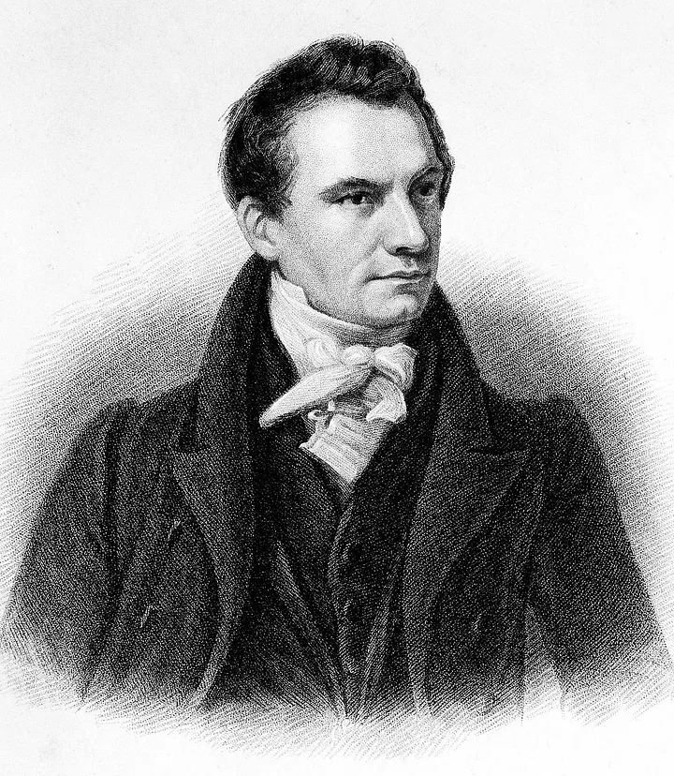
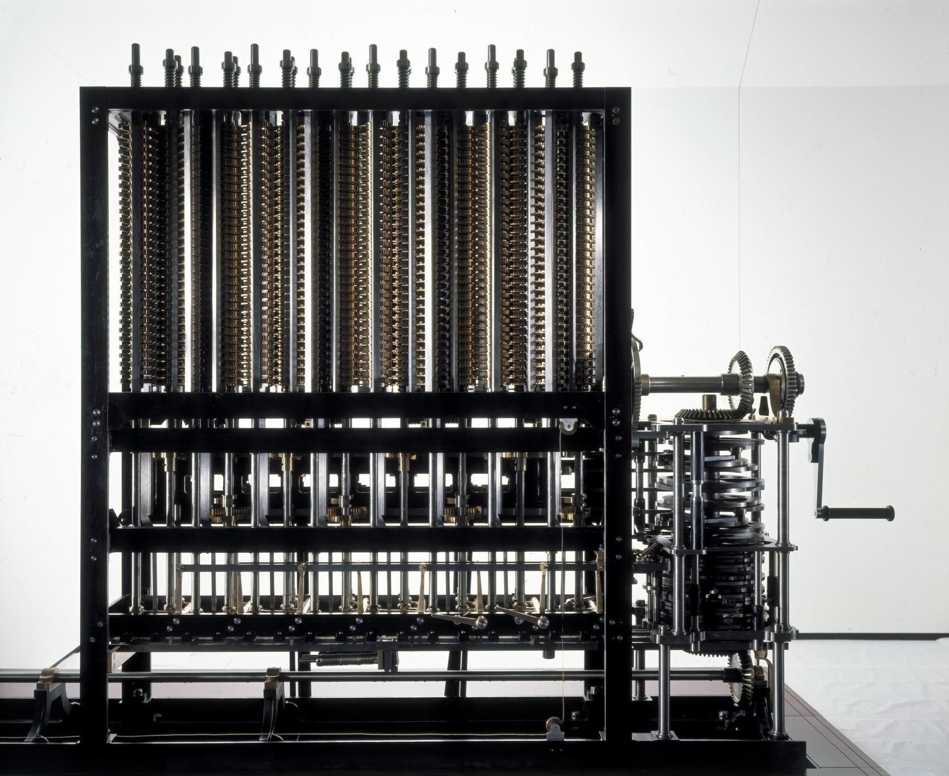
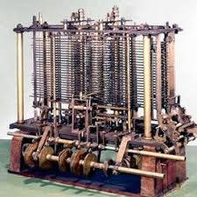
The Computer
In the 19th century, English mathematician Charles Babbage designed the "Difference Engine" and the "Analytical Engine." These were mechanical computers, and the Analytical Engine is considered a conceptual precursor to modern computers.
He is often called the "father of the computer."
Difference Engine
Analytical Engine

Slide 22
The Computer
Computers have evolved through several generations, each characterized by significant technological advancements:
Vacuum tubes
Transistors
Integrated circuits
Microprocessors
Personal computers
The internet, and cloud computing.
This rapid evolution has led to computers becoming smaller, faster, more powerful, and more accessible.

Slide 23
The Computer
Impact on Social Life:
Communication: The internet and email have revolutionized communication, connecting people across the globe.
Information Access: Computers have made vast amounts of information readily available.
Education: Computers have transformed education, enabling online learning and access to educational resources.
Commerce: E-commerce has changed the way we shop and conduct business.
Entertainment: Computers have revolutionized entertainment, with video games, streaming services, and online media.

Slide 24
The Computer
Impact on Social Life:
Social Networking: Social media platforms have connected people in new ways, but also raised concerns about privacy and social interaction.
Work: computers have changed the work place, and allowed for remote working.
Healthcare: Computers have aided in medical diagnosis, and record keeping.

Slide 25
ANY QUESTIONS ?

Slide 26
THANK YOU

